Slide 1

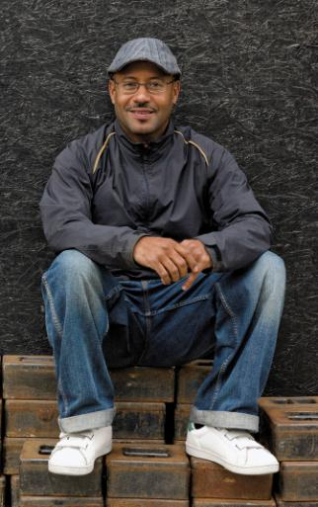

Project Overview
Cloud IOT Real Time Reinforcement Learning Engine: Computers that Teach Themselves
What is the project about?
Define the goal of this project
Define the scope of this project
https://www.linkedin.com/in/bill-schreiber-21590b6/
William.Schreiber.jr@gmail.com
Bill Schreiber
Notes:
What is the project about?
Define the goal of this project
Is it similar to projects in the past or is it a new effort?
Define the scope of this project
Is it an independent project or is it related to other projects?
* Note that this slide is not necessary for weekly status meetings

Slide 2
What is this about?
About software that teaches itself – VSLA algorithm
Variable Stochastic Learning Automaton
Will show two demos using VSLA library with REST interface in Cloud
Autonomous robot
Pong
XML interface
Real World Usage
Genetic Algorithms
Anytime a best strategy can be learned
Reinforced Learning
Another tool in the tool belt – place and time to use this
Notes:
* If any of these issues caused a schedule delay or need to be discussed further, include details in next slide.

Slide 3

VSLA models how a child learns. So, how does a child learn?
From experience….but what is experience? Whatever it is, it works, right?

Slide 4
So then, how does a child learn?
Something happens
React
Assess
Remember
Put hand on stove
Pull hand away
Ahhhhhhh!
Stove hot! Don’t touch
Get Input
Do Output
Did it work? Yes/No
Remember

Slide 5
Robot’s AI Actions Variable Stochastic Learning Automaton
Input
React
Try random action
Assess
Was it effective strategy against motivations? Yes/No
Remember
If yes, up chance for that action again. No, reduce chance will happen.
Notes:
The following slides show several examples of timelines using SmartArt graphics.
Include a timeline for the project, clearly marking milestones, important dates, and highlight where the project is now.

Slide 6
Example – Autonomous robot Need to know and figure out:
What can it do?
Backward, forward, left and right
What should it react to?
Bumper switch
What is/are the motivation(s)? What is the goal?
Not to run into things.

Slide 7
Example Robot Motivation: not to run into things
Hit Wall
React
Can back up, go forward, left, right or any combination.
Assess
Was it effective strategy against motivations? Yes/No
Remember
If yes, up chance for that action again. No, reduce chance will happen.
Notes:
The following slides show several examples of timelines using SmartArt graphics.
Include a timeline for the project, clearly marking milestones, important dates, and highlight where the project is now.

Slide 8
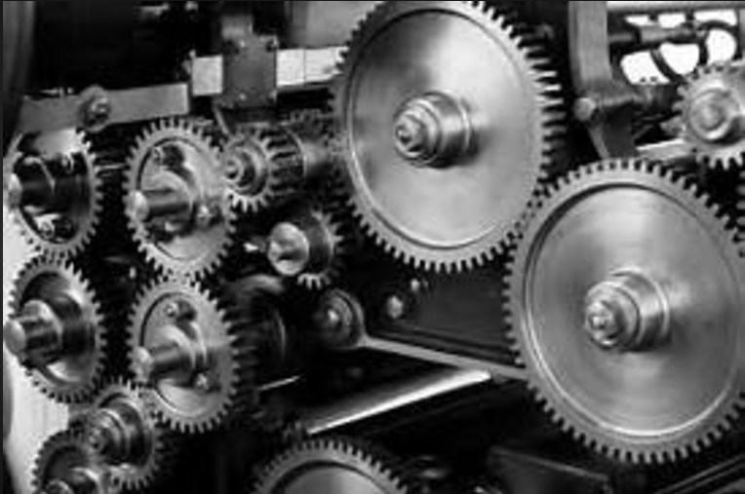
A lot going on with this…
…many moving parts
Notes:
The examples so far are very simple. Imagine something that is really complex.

Slide 9
Need to have separation of concerns Where do you draw the line?
Process on Server
Process on Both
Process on Device

Slide 10
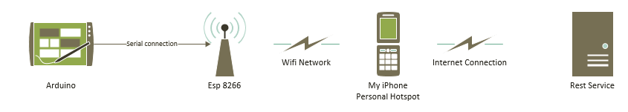
Demo Robot Overview
Notes:
The examples so far are very simple. Imagine something that is really complex.

Slide 11
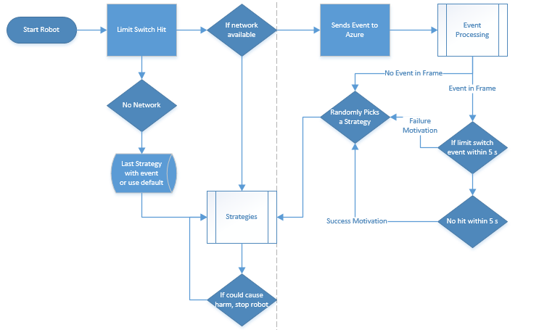
AI Workflow with Azure

Slide 12
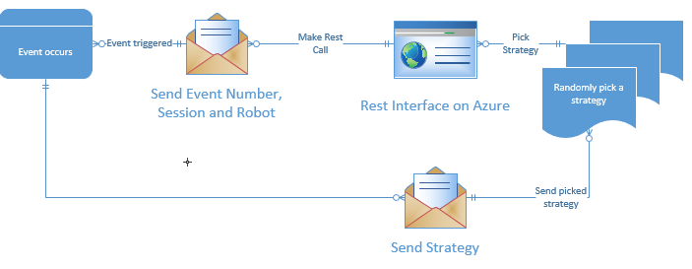
Easier to Read…. Azure AI REST Interface
Notes:
What are the dependencies that affect the timeline, cost, and output of this project?

Slide 13
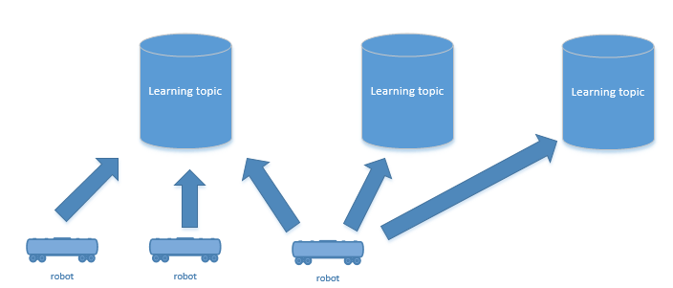
Allows multiple learning paths simultaneously
Share experience across devices.
Notes:
What are the dependencies that affect the timeline, cost, and output of this project?

Slide 14
Patterns of Experience and Possible Strategies
AI looks for input patterns from experience – doesn’t need to tell client –
Each input pattern then is given set of strategies to try and evaluate
Can specify action or strategy depth – these have to tell client – vaporware right now
Primitive actions can be tied together
XML example
Notes:
What are the dependencies that affect the timeline, cost, and output of this project?

Slide 15
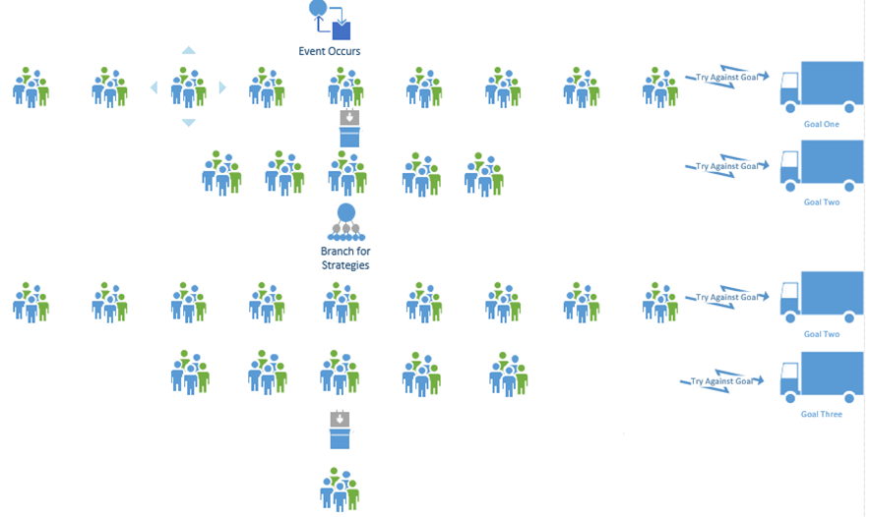
Strategy Management for Complex Problems
Notes:
What are the dependencies that affect the timeline, cost, and output of this project?

Slide 16
Pong Game
Inputs-Start Game, Right Paddle Hit, Left Paddle Hit, Bounce Up, Bounce Down
Outputs – strategy – move paddle to position
Motivators – hit right or left wall event
Example -
Start Game, Hit Left Paddle 100, Hit Right Paddle 222, Hit Up 207, Hit Down 110, Hit Left Wall
Start Game, Hit Left Paddle 65, Hit Up, Hit Down, Hit Right Wall
Notes:
What are the dependencies that affect the timeline, cost, and output of this project?

Slide 17
What about a game of Pong? Motivation is to have it hit enemy paddle or enemy wall.
Hit Player
Hit Enemy
Hit Player Wall
Hit Enemy Wall
Hit ceiling or floor
React
Move Paddle
Assess
Was it effective strategy against motivations? Yes/No
Remember
If yes, up chance for that action again. No, reduce chance will happen.
Notes:
The following slides show several examples of timelines using SmartArt graphics.
Include a timeline for the project, clearly marking milestones, important dates, and highlight where the project is now.

Slide 18

Complicating things a bit…
IsMotivator – is event something that tells us about success of a strategy – eg hitting a wall
DoesSystemRespondToEvent – is this something that we want to try a strategy on – eg hit enemy paddle, not an example = hitting ceiling or floor
IsFrameEventBoundary – is this an event that gives definitive start or end to the success of a strategy – eg. Start game, hit wall

Slide 19
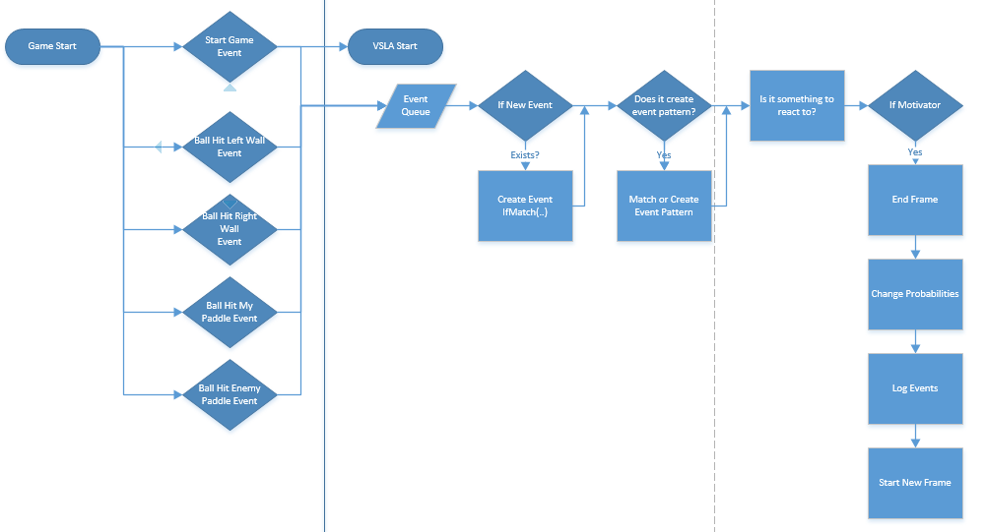
Pong Game Example

Slide 20
Web Page – Business Case
Inputs – Sensor Input
How much time spend on a page
Accuracy of work
How much contributed
Output = Strategy
Different UI’s – color schemes
Different Workflow
Motivations -
Longest on Page?
Shortest On Page?
Most contributed
Notes:
What are the dependencies that affect the timeline, cost, and output of this project?

Slide 21
How could this be used?
Genetic Algorithms – anytime a best strategy required
Play any board game including chess, go or checkers.
Learn how to best do something – place a brick, pickup a glass etc.
Medical – could be used to identify best set of strategies for breast cancer
Best UI for website – what is best UI?
Chat bot –what topics engages people the most?

Slide 22
Conclusion
So much to do
So much to learn…
Notes:
Prepare slides for the appendix in the event that more details or supplemental slides are needed. The appendix is also useful if the presentation is distributed later.

